Slide 1
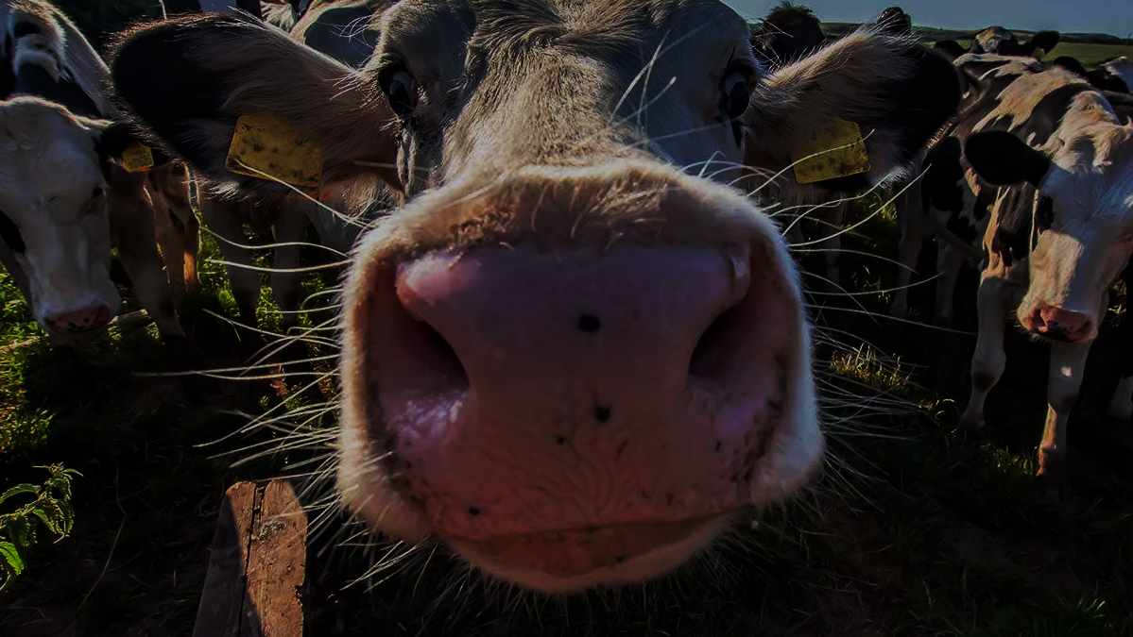
The interacting phenotype approach
Initially evolutionary biology for animal breeders (mostly)

Slide 2
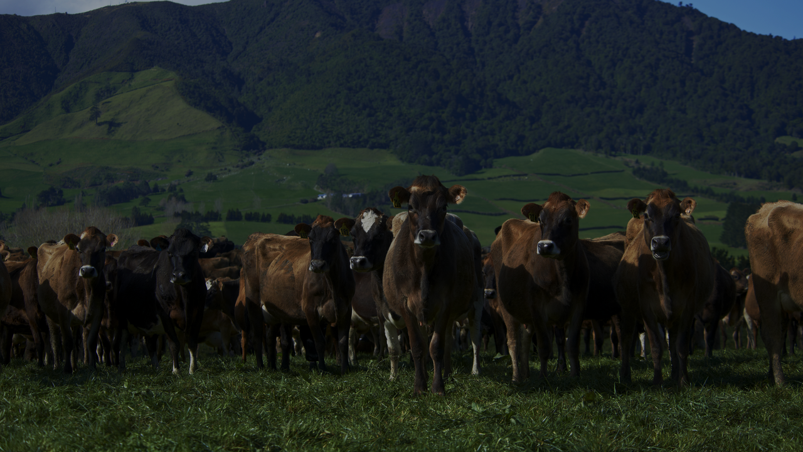
2) The interacting phenotype approach
Comes from quantitative genetics
Aims to predict micro-evolutionary changes in traits
Considers two components:
Phenotypic/genetic variation
Selection
Recently, expanded to analyse phenotypic variation over ecological timescales
Decomposes phenotypic variation into variation coming from genetic differences, developmental plasticity, and flexibility
Notes:
Now lets move to the interacting phenotype theory.
This is an approach which draws from the framework of quantitative genetics.
This framework was initially developed to describe and predict the evolution of complex phenotypic traits. to optimize artificial selection by animal breeders, to optimize artificial selection to improve, say, meat production, growth, mass, or milk yield.
The framework makes simplifying assumptions, by assuming that traits are affected by a large number of alleles, each with a tiny effect on the phenotype value of the individual. Some alleles will decrease this phenotype value by x, some will increase by y, etc…
This framework uses linear modelling (regressions,anovas) to describe the variation in all these alleles that exists among individuals in the population. In fact, regression and anova were developed for this precise theory and some related aspects of evolutionary theory.
More recently, several researchers have pushed expanding this framework to analyse animal behaviour.
Behaivour is plastic, and so this prompted the development of quantitative genetics framworks able to describe how organisms adjust their phenotypes to the conditions in the environment. The way that we model plasticity with this approach is often called reaction norms. Another approach is called the character state approach. We can discuss this later if you are interested.

Slide 3
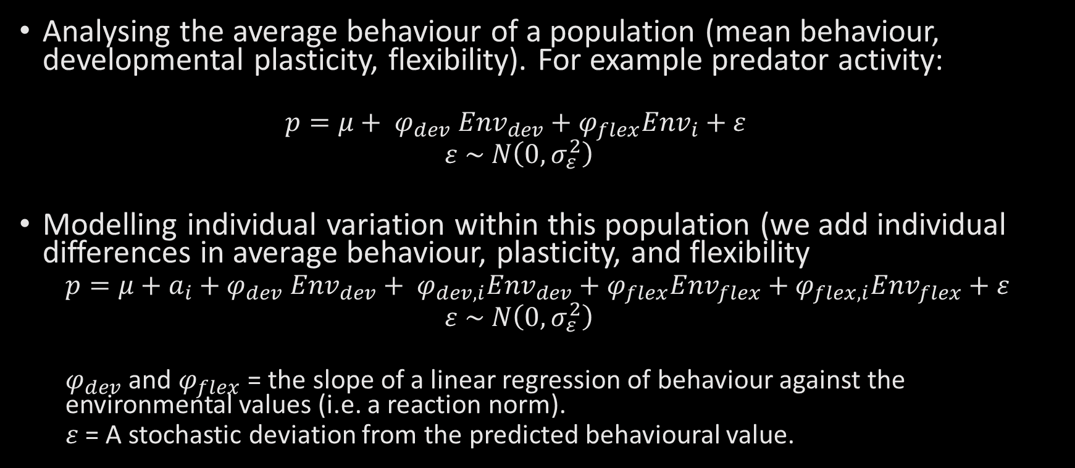
The basics
Analysing the average behaviour of a population (mean behaviour, developmental plasticity, flexibility). For example predator activity:
$$p=μ+ φ_{dev} {Env}_{dev}+φ_{flex}{Env}_{i}+ε$$
$$ε \sim N\left(0, σ_{ε}^{2}\right)$$
Modelling individual variation within this population (we add individual differences in average behaviour, plasticity, and flexibility
$$p=μ+a_{i}+φ_{dev} {Env}_{dev}+ φ_{dev, i}{Env}_{dev}+φ_{flex}{Env}_{flex}+φ_{flex,i}{Env}_{flex}+ε$$
$$ε \sim N\left(0, σ_{ε}^{2}\right)$$
$φ_{dev}$ and $φ_{flex}$= the slope of a linear regression of behaviour against the environmental values (i.e. a reaction norm).
$ε$= A stochastic deviation from the predicted behavioural value.
Notes:
OK, so what does this looks like? If you are using interacting phenotype theory, this is how you think of individual behaviour.:
The average trait value of a population of indviduals, here it could be its level of aggressiveness or its speed for example, is determined by the population’s average (mu), but also by the plastic response of the population to the current environmental conditions it experiences.
For example, here, individuals could have a tendency to increase their aggressiveness with the density of conspecifics during their development. This reaction norm (or the slope of the relationship between aggressiveness and density, here phidev) would describe the average developmental plasticity of individuals.
Individuals could also exhibit flexibility, or plastic changes in behaviour that are in response to immediate conditions and that might be reversible. For example here, they could decrease their level of aggressiveness with the amount of food they have secured in the past 2hours. This is described by phiflex
And finally, individual behaviour has a stochastic component that you cannot really describe or explain, and it is modelled using epsilon, the residual value. We cannot estimate the value of this stochastic component, but we can estimate its contribution to the variance in phenotypes that we observe in our populations (this is the residual variance in a linear model).
If you have enough data, mainly, repeated observations on marked individuals in different environments (for example that were raised at different densities, or with different energetic states) then you can also estimate the average and the developmental and flexible reaction norms for each individual of the dataset separately.
In the model, this takes the form of individual deviations from the population parameters (which describes the average). So here you would have deviations among individuals in their average phenotype. This means that some individuals are going to be always more aggressive on average.
You can also have differences in their reaction norms for developmental plasticity and flexibility.

Slide 4
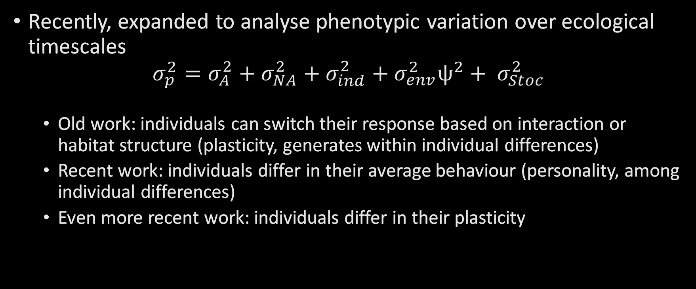
The extensions
Recently, expanded to analyse phenotypic variation over ecological timescales
$$σ_{p}^{2}=σ_{A}^{2}+σ_{NA}^{2}+σ_{ind}^{2}+σ_{env}^{2}ψ^{2}+ σ_{Stoc}^{2}$$
Old work: individuals can switch their response based on interaction or habitat structure (plasticity, generates within individual differences)
Recent work: individuals differ in their average behaviour (personality, among individual differences)
Even more recent work: individuals differ in their plasticity

Slide 5
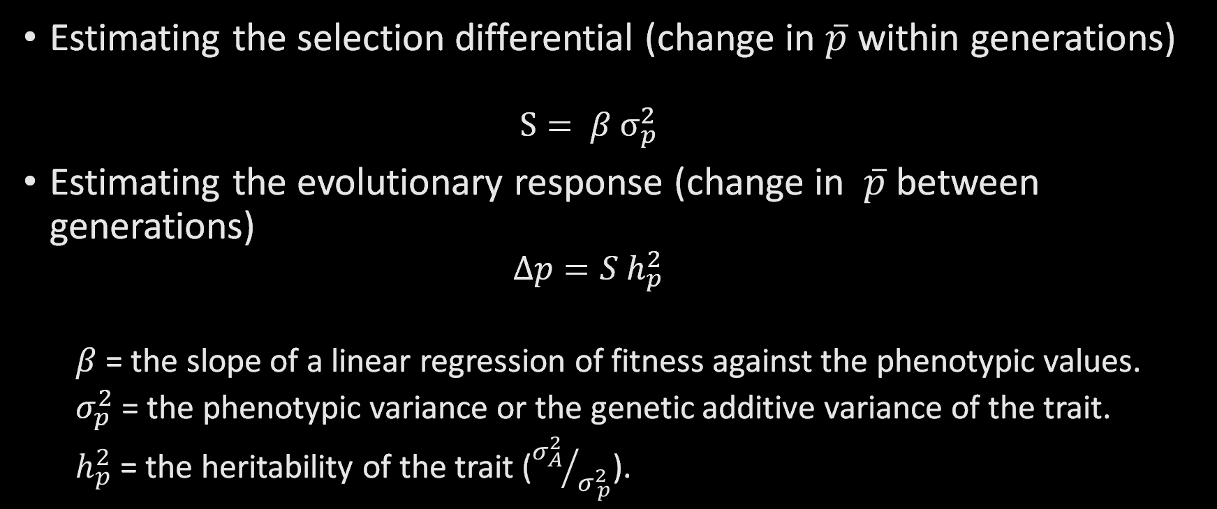
The basics
Estimating the selection differential (change in $\overline{p}$ within generations)
$$S= β σ_{p}^{2}$$
Estimating the evolutionary response (change in $\overline{p}$ between generations)
$$∆p=S h_{p}^{2}$$
$β$ = the slope of a linear regression of fitness against the phenotypic values.
$σ_{p}^{2}$ = the phenotypic variance or the genetic additive variance of the trait.
$h_{p}^{2}$ = the heritability of the trait (${σ_{A}^{2}}/{σ_{ p}^{2}}$).
Notes:
If we apply the same idea to fitness, we could model it as if it was a trait that individuals can express.
By regressing the phenotype of individuals on their fitness, we can estimate selection gradients.
We can use the selection gradient (which is a slope estimate) and multiply it by the phenotype variance (the measurement of the differences in phenotypes among individuals), then we obtain the selection differential, or the variation in fitness that is attributable to the phenotypic differences among individuals.
And you can use this selection differential to multiply it with the heritability of the trait (the extent to which differences among individuals in their phenotype are transmitted from one generation to the next), to predict how much the average phenotype of the population will change from one generation to the next.
We will not focus on heritability at this point, because our analyses on the TrophEI game will not allow us to analyse the genetic underpinnings of your behaviour (!) but I can tell you more about it if you want.

Slide 6
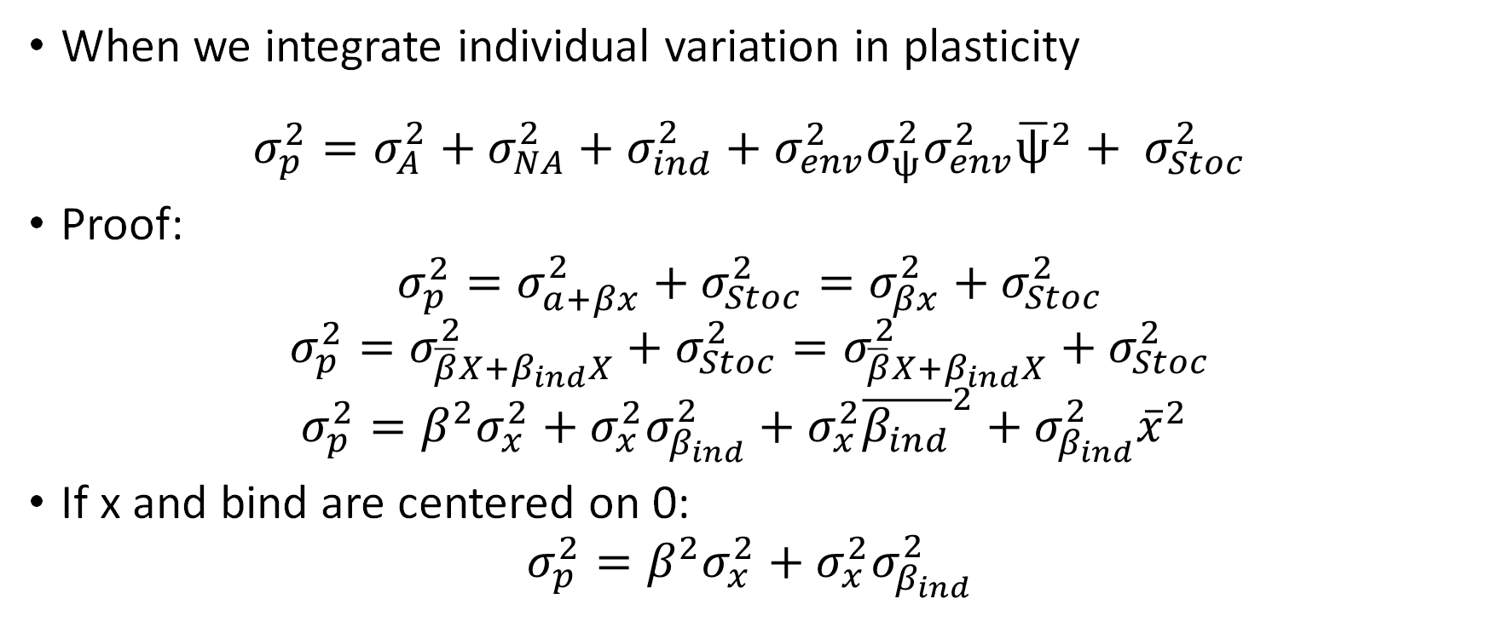
proof
When we integrate individual variation in plasticity
$$σ_{p}^{2}=σ_{A}^{2}+σ_{NA}^{2}+σ_{ind}^{2}+σ_{env}^{2}σ_{ψ}^{2}σ_{env}^{2}{\overline{ψ}}^{2}+ σ_{Stoc}^{2}$$
Proof:
$$σ_{p}^{2}=σ_{a+βx}^{2}+σ_{Stoc}^{2}=σ_{βx}^{2}+σ_{Stoc}^{2}$$
$$σ_{p}^{2}=σ_{\overline{β}X+β_{ind}X}^{2}+σ_{Stoc}^{2}=σ_{\overline{β}X+β_{ind}X}^{2}+σ_{Stoc}^{2}$$
$$σ_{p}^{2}=β^{2}σ_{x}^{2}+σ_{x}^{2}σ_{β_{ind}}^{2}+σ_{x}^{2}{\overline{β_{ind}}}^{2}+σ_{β_{ind}}^{2}{\overline{x}}^{2}$$
If x and bind are centered on 0:
$$σ_{p}^{2}=β^{2}σ_{x}^{2}+σ_{x}^{2}σ_{β_{ind}}^{2}$$

Slide 7
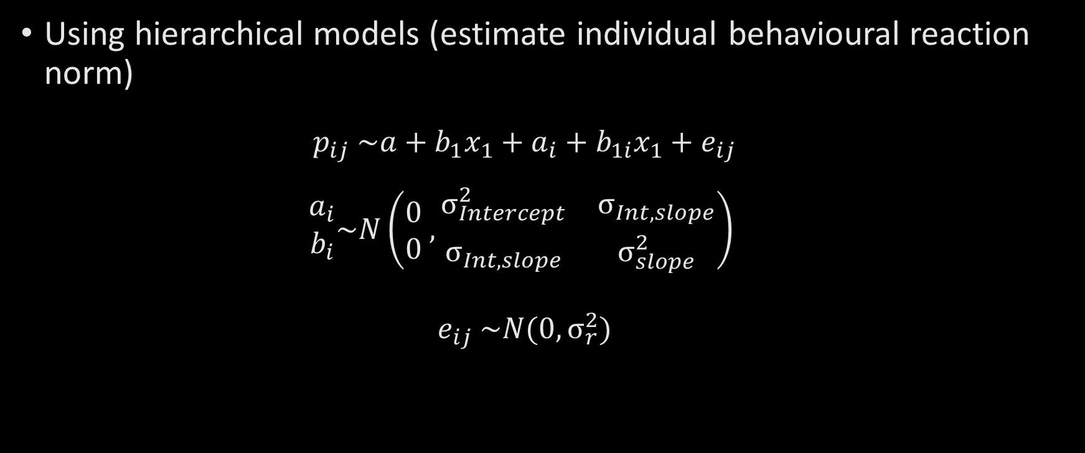
Quantifying behavioural variation & selection
Using hierarchical models (estimate individual behavioural reaction norm)
$$p_{ij} \sim a+b_{1}x_{1}+a_{i}+b_{1i}x_{1}+e_{ij}$$
$$\begin{matrix}a_{i} \\ b_{i}\end{matrix}\sim N\left(\begin{matrix}0 \\ 0\end{matrix} , \begin{matrix}σ_{Intercept}^{2} & σ_{Int,slope} \\ σ_{Int,slope} & σ_{slope}^{2}\end{matrix}\right)$$
$$e_{ij} \sim N(0, σ_{r}^{2})$$
Notes:
So how do we quantify these parameters describing individual variation in behaviour, in plasticity, etc. ?
We now use hierarchical models. (or mixed models).
These models are called like this because they have two layers of parameters.
One layer describes the mean effect of several explanatory values (we call these parameters the fixed effects).
This is the part that will model the population’s average phenotype, and average plasticity.

Slide 8
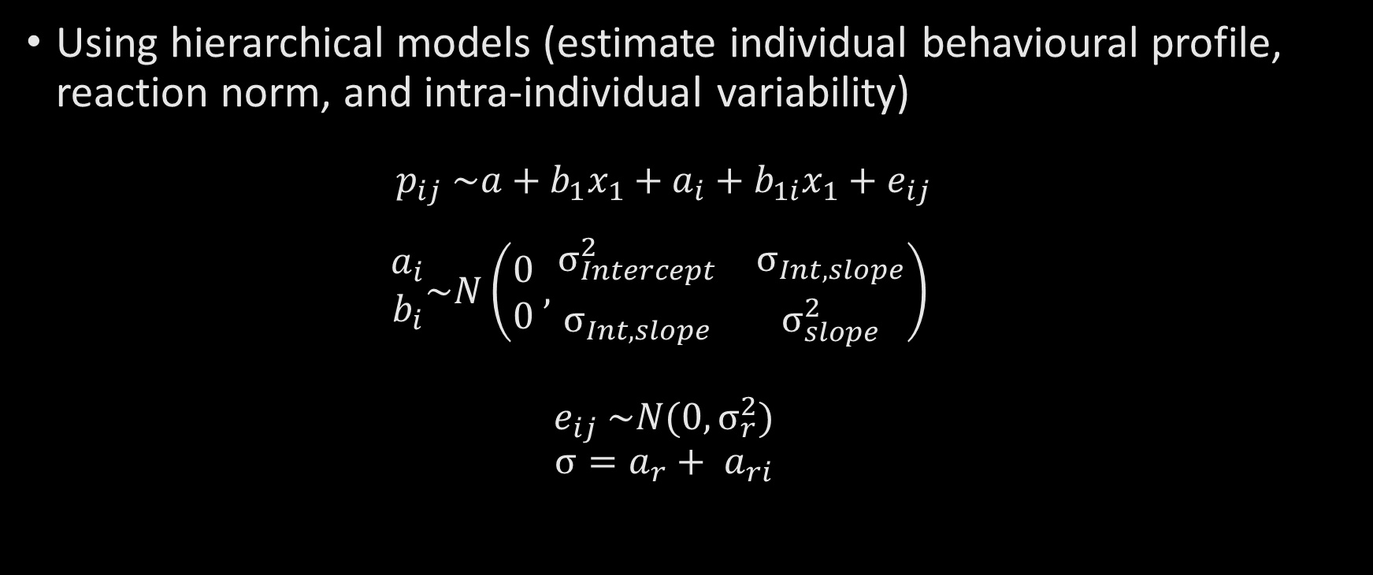
Quantifying behavioural variation & selection
Using hierarchical models (estimate individual behavioural profile, reaction norm, and intra-individual variability)
$$p_{ij} \sim a+b_{1}x_{1}+a_{i}+b_{1i}x_{1}+e_{ij}$$
$$\begin{matrix}a_{i} \\ b_{i}\end{matrix}\sim N\left(\begin{matrix}0 \\ 0\end{matrix} , \begin{matrix}σ_{Intercept}^{2} & σ_{Int,slope} \\ σ_{Int,slope} & σ_{slope}^{2}\end{matrix}\right)$$
$$e_{ij} \sim N(0, σ_{r}^{2})$$
$$σ=a_{r}+ a_{ri}$$
Mean model
Dispersion model

Slide 9
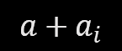
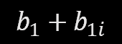
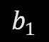

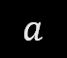
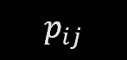

Quantifying behavioural variation & selection
What does this mean?
$$\hat{p_{ij}} \sim a+b_{1}x_{1}+a_{i}+b_{1i}x_{1}$$
$$p_{ij}$$
$$b_{1}$$
$$b_{1}+b_{1i}$$
$$a$$
$$a+a_{i}$$
$$x_{1}$$
Notes:
The remaining slides are meant to give you a visual intuition of all these parameters and what they represent in biological terms.
First, the simplest way to describe how an individual’s or a population’s behaviour changes with environmental conditions is to use a linear function, taking the value of an environmental variable.
for example here it could be the density of prey, the average temperature, etc. and predicting a behavioural trait value.
This environmental value is represented on the x axis.
On the y axis, you would have the predicted behavioural trait value of individuals.
This is our reaction norm for the population, or the average reaction norm.
You have the environmental variable in x, the average behaviour in Y and the Phi (or the slope) links the two.
Now you can fit a different intercept and slope for each individual like this….
And the model will estimate the variance in intercepts among individuals, the variance in slopes among individuals.
Both parameter are necessary to draw the reaction norm of each individual.

Slide 10

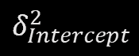
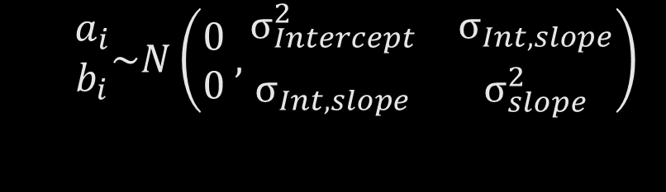
Quantifying behavioural variation & selection
What does this mean?
$$\begin{matrix}a_{i} \\ b_{i}\end{matrix}\sim N\left(\begin{matrix}0 \\ 0\end{matrix} , \begin{matrix}σ_{Intercept}^{2} & σ_{Int,slope} \\ σ_{Int,slope} & σ_{slope}^{2}\end{matrix}\right)$$
$$p_{ij}$$
$$δ_{Intercept}^{2}$$
$$x_{1}$$
Notes:
The model also has a second layer of parameters (random effects), which describes the variation accounted for by deviations that individuals express in a systematic way from the population’s parameters.
This is a second layer, because the model is estimating the variance of these deviations rather than trying to model each individual deviation perfectly.
These second layer of parameters is contained in a variance covariance matrix.
Lets look at the meaning of these parameters together.
The first is the variance in intercepts.
It describes the extent to which individuals differ in the elevation of their reaction norm.
A big variance would mean for example that some individuals are always more aggressive than others on average, even if everyone can adjust its behaviour in response to the environment.

Slide 11
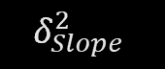
Quantifying behavioural variation & selection
What does this mean?
$$\begin{matrix}a_{i} \\ b_{i}\end{matrix}\sim N\left(\begin{matrix}0 \\ 0\end{matrix} , \begin{matrix}σ_{Intercept}^{2} & σ_{Int,slope} \\ σ_{Int,slope} & σ_{slope}^{2}\end{matrix}\right)$$
$$p_{ij}$$
$$δ_{Slope}^{2}$$
$$x_{1}$$
Notes:
The model also estimates the variance in slopes among individuals.
A large variance here would indicate that individuals differ not only in their average behaviour, but more in the way they respond to a change in environmental conditions.
For example some could increase their aggressiveness in response to an increase in density while others have a flat reaction norm, or even decrease it.

Slide 12
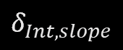
Quantifying behavioural variation & selection
What does this mean?
$$\begin{matrix}a_{i} \\ b_{i}\end{matrix}\sim N\left(\begin{matrix}0 \\ 0\end{matrix} , \begin{matrix}σ_{Intercept}^{2} & σ_{Int,slope} \\ σ_{Int,slope} & σ_{slope}^{2}\end{matrix}\right)$$
$$p_{ij}$$
$$δ_{Int, slope}$$
$$x_{1}$$
Notes:
…. A parameter that we forget often, is the covariance between the two deviations.
The covariance between the individual intercepts and the individual slopes.
The covariance tells us the shape of all the reaction norms of individuals when you consider them together.
For example the reaction norm could be fanning out in such a way that we see an increase in behavioral differences among individuals as we move right along the environmental axis (we would see greater differences in aggressiveness as we increase density).

Slide 13

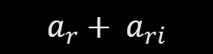
Quantifying behavioural variation & selection
What does this mean?
$$σ_{r}^{2}=a_{r}+ a_{ri}$$
$$p_{ij}$$
$$a_{r}+ a_{ri}$$
$$x_{1}$$

Slide 14
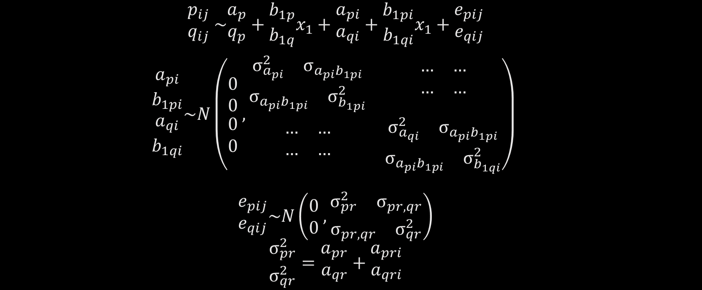
Going multivariate
$$\begin{matrix}p_{ij} \\ q_{ij}\end{matrix} \sim \begin{matrix}a_{p} \\ q_{p}\end{matrix}+\begin{matrix}b_{1p} \\ b_{1q}\end{matrix}x_{1}+\begin{matrix}a_{pi} \\ a_{qi}\end{matrix}+\begin{matrix}b_{1pi} \\ b_{1qi}\end{matrix}x_{1}+\begin{matrix}e_{pij} \\ e_{qij}\end{matrix}$$
$$\begin{matrix}\begin{matrix}a_{pi} \\ b_{1pi}\end{matrix} \\ \begin{matrix}a_{qi} \\ b_{1qi}\end{matrix}\end{matrix}\sim N\left(\begin{matrix}\begin{matrix}0 \\ 0\end{matrix} \\ \begin{matrix}0 \\ 0\end{matrix}\end{matrix} ,\begin{matrix}\begin{matrix}\begin{matrix}σ_{a_{pi}}^{2} & σ_{a_{pi}b_{1pi}}\end{matrix} \\ \begin{matrix}σ_{a_{pi}b_{1pi}} & σ_{b_{1pi}}^{2}\end{matrix}\end{matrix} & \begin{matrix}\begin{matrix}… & …\end{matrix} \\ \begin{matrix}… & …\end{matrix}\end{matrix} \\ \begin{matrix}\begin{matrix}… & …\end{matrix} \\ \begin{matrix}… & …\end{matrix}\end{matrix} & \begin{matrix}\begin{matrix}σ_{a_{qi}}^{2} & σ_{a_{pi}b_{1pi}}\end{matrix} \\ \begin{matrix}σ_{a_{pi}b_{1pi}} & σ_{b_{1qi}}^{2}\end{matrix}\end{matrix}\end{matrix}\right)$$
$$\begin{matrix}e_{pij} \\ e_{qij}\end{matrix}\sim N\left(\begin{matrix}0 \\ 0\end{matrix} , \begin{matrix}\begin{matrix}σ_{pr}^{2} & σ_{pr, qr}\end{matrix} \\ \begin{matrix}σ_{pr, qr} & σ_{qr}^{2}\end{matrix}\end{matrix}\right)$$
$$\begin{matrix}σ_{pr}^{2} \\ σ_{qr}^{2}\end{matrix}=\begin{matrix}a_{pr} \\ a_{qr}\end{matrix}+\begin{matrix}a_{pri} \\ a_{qri}\end{matrix}$$
Notes:
We can do this for a single behaviour or for a single fitness component at a time.
But it is also possible to use the same models in a multivariate form, where they will analyse several traits simultaneously.
For example, you could be interested in the speed of movement and the size of the prey captured by predators, so you could analyse them both at the same time.
In this model, you would estimate the same parameters for each traits for the population.
You would also be able to estimate individual differences in each of these parameters.
But if you look at this second layer of parameters, the random effects you can also extract the relationships among these deviations.
For example you will obtain an estimate of the relationship between the individual average deviations of both traits to determine if individuals that are on average faster in their movement are also capturing bigger or smaller prey (this would be the covariance between api and aqi.
You could also determine whether indivdiuals that are more plastic in their speed of movement (this is the b1pi parameter) are also more plastic in the size of their prey,… etc.

Slide 15
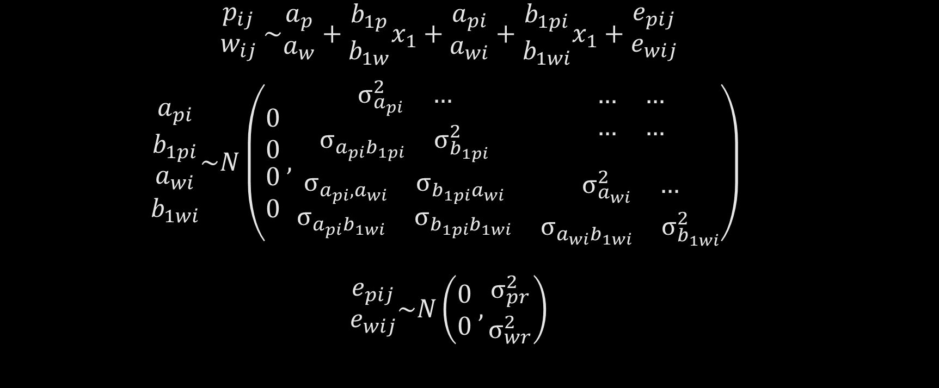
Estimating linear selection
$$\begin{matrix}p_{ij} \\ w_{ij}\end{matrix} \sim \begin{matrix}a_{p} \\ a_{w}\end{matrix}+\begin{matrix}b_{1p} \\ b_{1w}\end{matrix}x_{1}+\begin{matrix}a_{pi} \\ a_{wi}\end{matrix}+\begin{matrix}b_{1pi} \\ b_{1wi}\end{matrix}x_{1}+\begin{matrix}e_{pij} \\ e_{wij}\end{matrix}$$
$$\begin{matrix}\begin{matrix}a_{pi} \\ b_{1pi}\end{matrix} \\ \begin{matrix}a_{wi} \\ b_{1wi}\end{matrix}\end{matrix}\sim N\left(\begin{matrix}\begin{matrix}0 \\ 0\end{matrix} \\ \begin{matrix}0 \\ 0\end{matrix}\end{matrix} ,\begin{matrix}\begin{matrix}\begin{matrix}σ_{a_{pi}}^{2} & …\end{matrix} \\ \begin{matrix}σ_{a_{pi}b_{1pi}} & σ_{b_{1pi}}^{2}\end{matrix}\end{matrix} & \begin{matrix}\begin{matrix}… & …\end{matrix} \\ \begin{matrix}… & …\end{matrix}\end{matrix} \\ \begin{matrix}\begin{matrix}σ_{a_{pi},a_{wi}} & σ_{b_{1pi}a_{wi}}\end{matrix} \\ \begin{matrix}σ_{a_{pi}b_{1wi}} & σ_{b_{1pi}b_{1wi}}\end{matrix}\end{matrix} & \begin{matrix}\begin{matrix}σ_{a_{wi}}^{2} & …\end{matrix} \\ \begin{matrix}σ_{a_{wi}b_{1wi}} & σ_{b_{1wi}}^{2}\end{matrix}\end{matrix}\end{matrix}\right)$$
$$\begin{matrix}e_{pij} \\ e_{wij}\end{matrix}\sim N\left(\begin{matrix}0 \\ 0\end{matrix} , \begin{matrix}σ_{pr}^{2} \\ σ_{wr}^{2}\end{matrix}\right)$$
Notes:
Using a multivariate model, we can also estimate the selection acting on behavioural traits by estimating the covariance between fitness and behavioural traits.
For us to achieve this, we need to construct a model where one of the responses is the fitness measure and the other response variables are the behaviours you want to analyse.
When you do this, the variance covariance matrix of the random effect will provide you with the variance in behaviour and in plasticity, just as before, but it will also give you the covariance between fitness and each of these individual parameters.
This covariance is telling you whether there is selection on these aspects of individual behaviour.
Now it is your turn.
The idea is to reanalyse the data used by maxime in his paper, that you should have all read?
You will be able to estimate the different parameters we have talked about, and to see what they mean in the context of predator-prey interactions….
Time to open R on your computers!

Slide 16
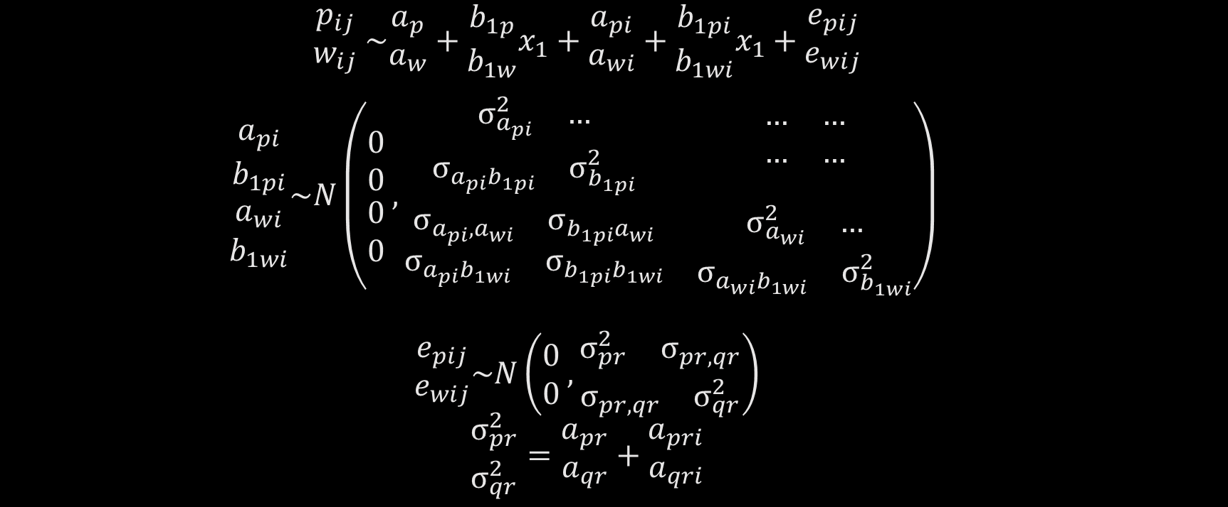
Estimating linear selection
$$\begin{matrix}p_{ij} \\ w_{ij}\end{matrix} \sim \begin{matrix}a_{p} \\ a_{w}\end{matrix}+\begin{matrix}b_{1p} \\ b_{1w}\end{matrix}x_{1}+\begin{matrix}a_{pi} \\ a_{wi}\end{matrix}+\begin{matrix}b_{1pi} \\ b_{1wi}\end{matrix}x_{1}+\begin{matrix}e_{pij} \\ e_{wij}\end{matrix}$$
$$\begin{matrix}\begin{matrix}a_{pi} \\ b_{1pi}\end{matrix} \\ \begin{matrix}a_{wi} \\ b_{1wi}\end{matrix}\end{matrix}\sim N\left(\begin{matrix}\begin{matrix}0 \\ 0\end{matrix} \\ \begin{matrix}0 \\ 0\end{matrix}\end{matrix} ,\begin{matrix}\begin{matrix}\begin{matrix}σ_{a_{pi}}^{2} & …\end{matrix} \\ \begin{matrix}σ_{a_{pi}b_{1pi}} & σ_{b_{1pi}}^{2}\end{matrix}\end{matrix} & \begin{matrix}\begin{matrix}… & …\end{matrix} \\ \begin{matrix}… & …\end{matrix}\end{matrix} \\ \begin{matrix}\begin{matrix}σ_{a_{pi},a_{wi}} & σ_{b_{1pi}a_{wi}}\end{matrix} \\ \begin{matrix}σ_{a_{pi}b_{1wi}} & σ_{b_{1pi}b_{1wi}}\end{matrix}\end{matrix} & \begin{matrix}\begin{matrix}σ_{a_{wi}}^{2} & …\end{matrix} \\ \begin{matrix}σ_{a_{wi}b_{1wi}} & σ_{b_{1wi}}^{2}\end{matrix}\end{matrix}\end{matrix}\right)$$
$$\begin{matrix}e_{pij} \\ e_{wij}\end{matrix}\sim N\left(\begin{matrix}0 \\ 0\end{matrix} , \begin{matrix}\begin{matrix}σ_{pr}^{2} & σ_{pr, qr}\end{matrix} \\ \begin{matrix}σ_{pr, qr} & σ_{qr}^{2}\end{matrix}\end{matrix}\right)$$
$$\begin{matrix}σ_{pr}^{2} \\ σ_{qr}^{2}\end{matrix}=\begin{matrix}a_{pr} \\ a_{qr}\end{matrix}+\begin{matrix}a_{pri} \\ a_{qri}\end{matrix}$$

